Slide 1
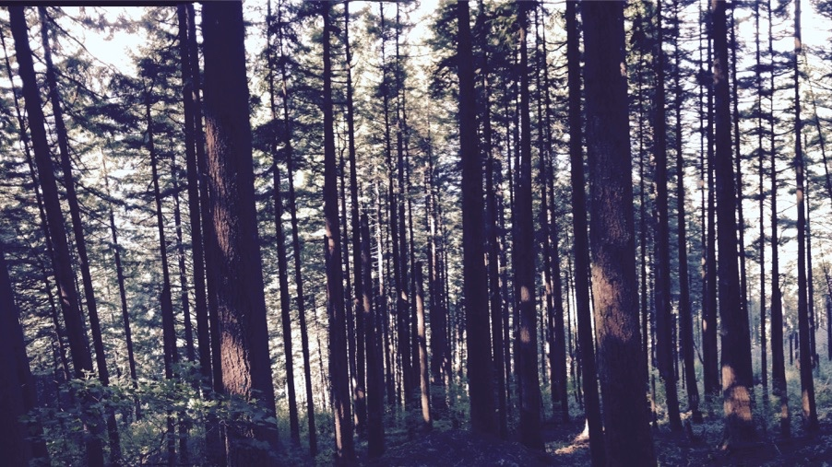
Photosynthetic least-cost optimality theory
Nick Smith
Department of Biological Sciences
Texas Tech University

Slide 2
Photosynthetic acclimation

Slide 3
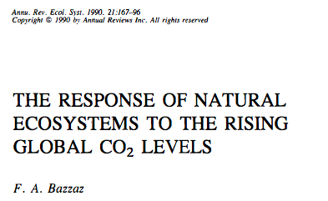
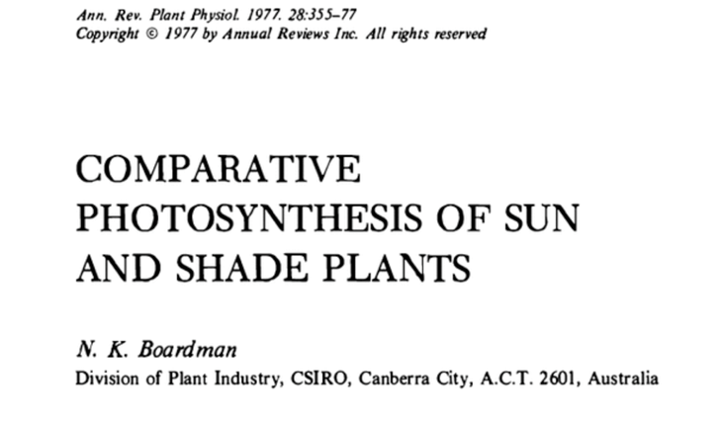
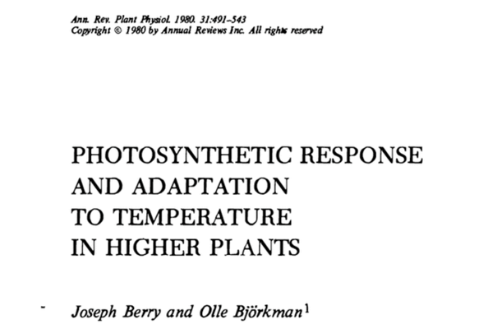
We know that plants adjust photosynthetic traits to changes in environmental conditions
nick.smith@ttu.edu
Temperature: Berry & Björkman (1980)
CO₂: Bazzaz (1990)
Light: Boardman (1977)

Slide 4
Acclimation: an example
Acclimated to high light
Acclimated to low light

Slide 5
Acclimation: an example
Acclimated to high light
Acclimated to low light
Photosynthesis peaks a light level close to the level the leaf is acclimated to

Slide 6
A general theory to explain photosynthetic acclimation: photosynthetic least cost theory

Slide 7
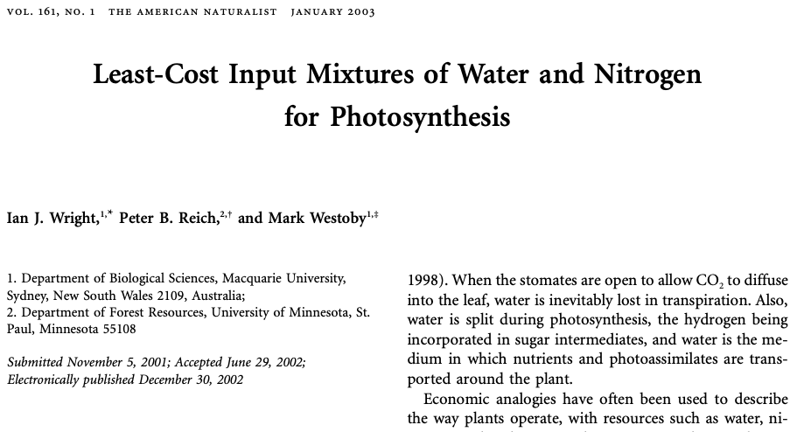

Slide 8
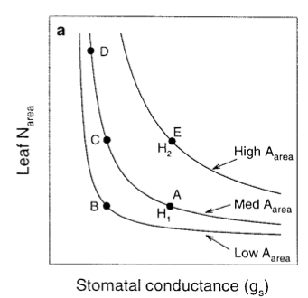
A = f{enzymes} * f{Ci}
A ~ N * gs

Slide 9
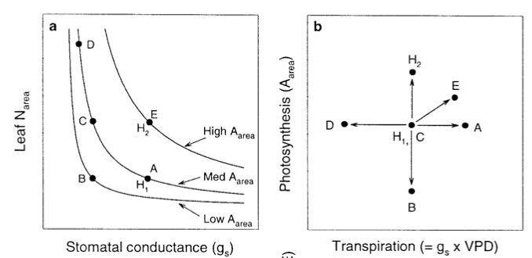

Slide 10
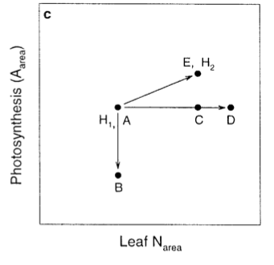

Slide 11
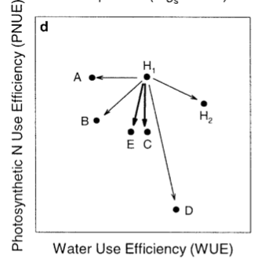

Slide 12
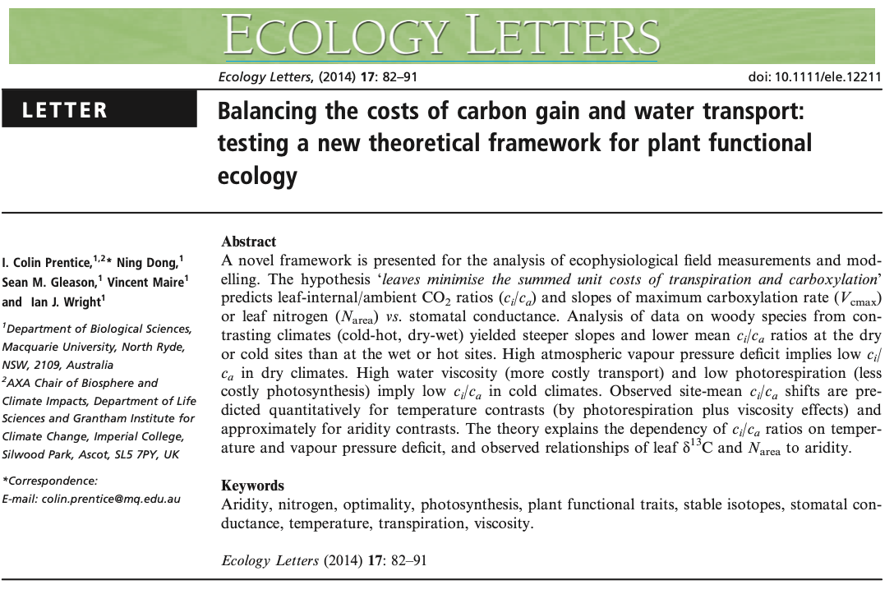

Slide 13
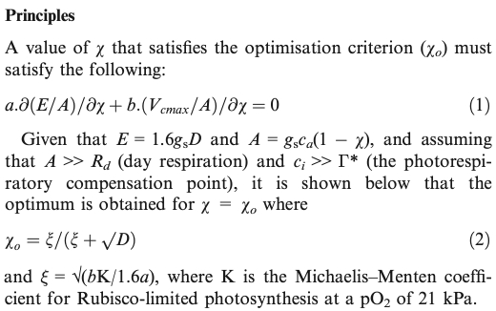
χ = ratio of CO₂ inside to outside the leaf
a = carbon cost of maintaining transpiration to support photosynthesis
b = carbon cost of maintaining photosynthetic enzymes
β = b/a

Slide 14
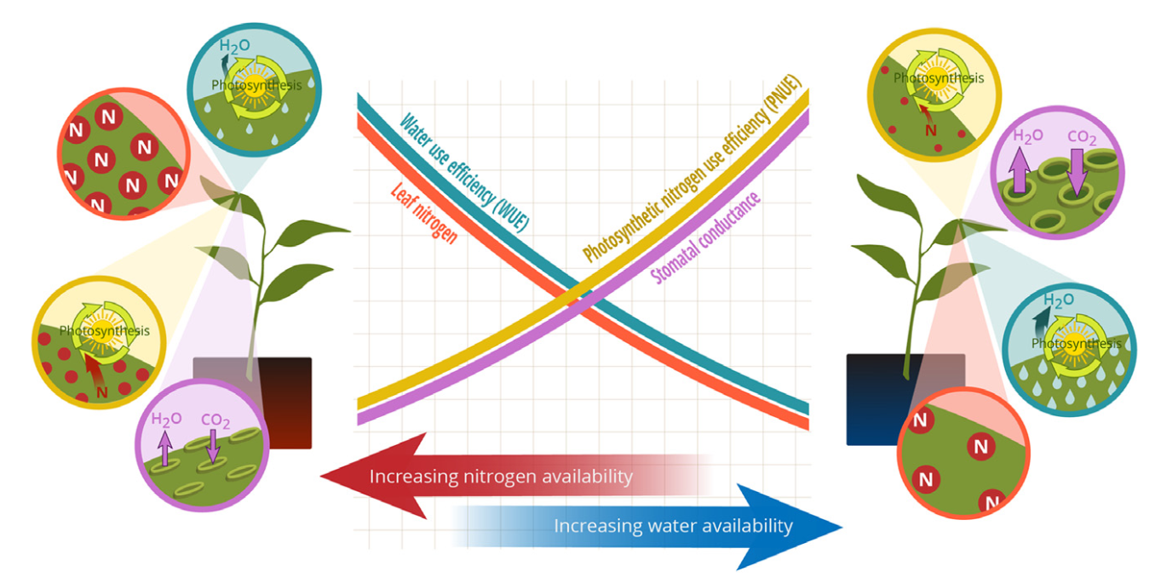
Bialic-Murphy et al. (2021)

Slide 15
β, χ
Bialic-Murphy et al. (2021)

Slide 16
β, χ
Photosynthesis
Bialic-Murphy et al. (2021)

Slide 17
V_{cmax}
χ

Slide 18
Does it work?

Slide 19
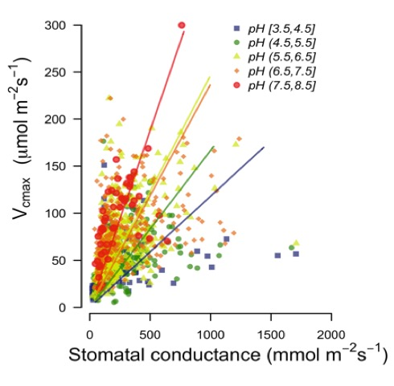
Paillassa et al. (2020)

Slide 20
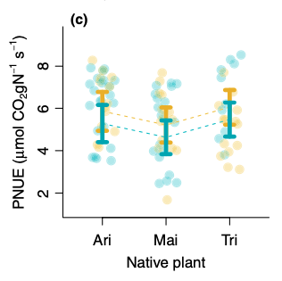
Bialic-Murphy et al. (2021)

Slide 21
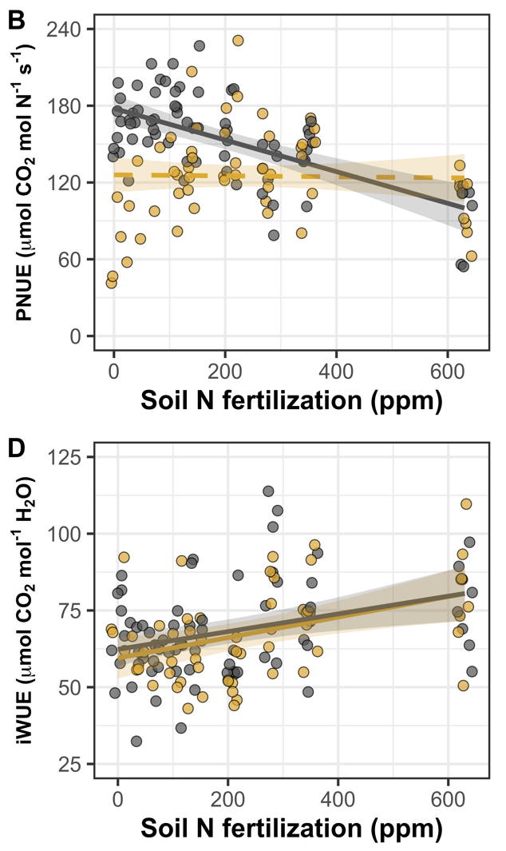
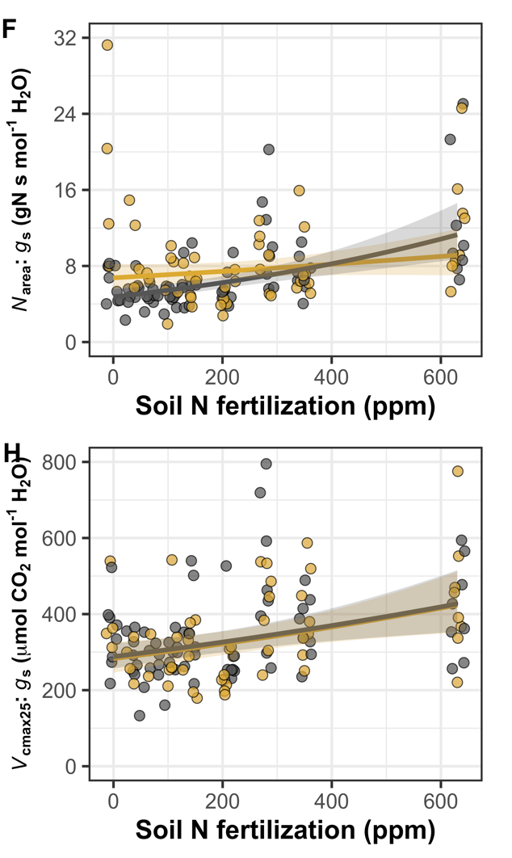

Perkowski et al. (in prep)

Slide 22
Why does it matter for our project?

Slide 23
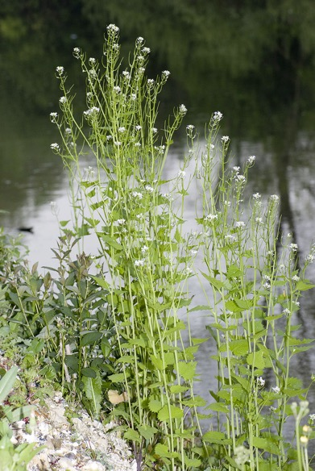
IntBio implications
Provides a framework for understanding how Alliaria invasion-induced disruptions in mycorrhizal networks impacts plant physiology
Can predict that antibi plants in invaded plots will have:
Higher β
Higher χ
Lower V_{cmax}
Lower leaf N and P
Higher costs for uptaking N and P

Slide 24
IntBio implications
V_{cmax}
χ
Decreasing invasion

Slide 25
Some yet unresolved questions
What really is β?
Are there leaf-whole plant tradeoffs?
What are implications for vital rates and demography?
Are there species-specific responses? Why?

Slide 26
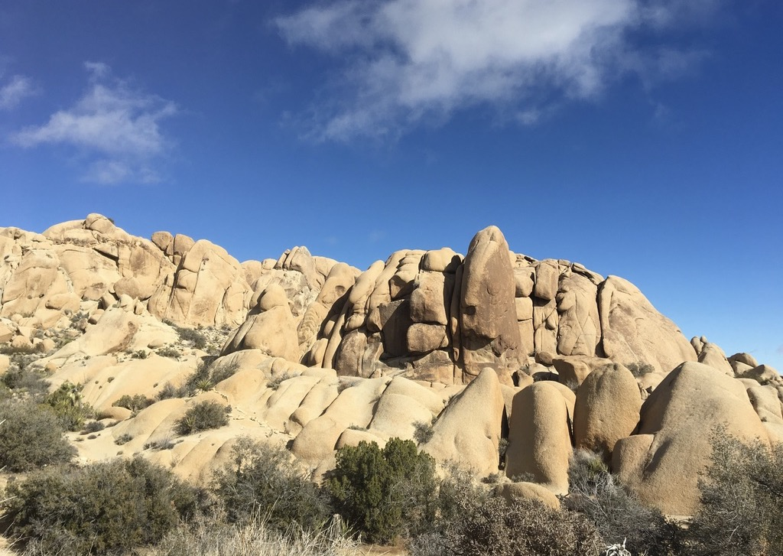
Presentation available at:
www.github.com/SmithEcophysLab/seminar/2023_intbio
Thanks!

